Slide 1

Effects of meltdown and spectre on the internet of things
NYU Tandon School of Engineering
CS-GY6233
Research Abstract

Slide 2
Overview
What is Meltdown and Spectre
How it works
Why its bad
Tests conducted
Conclusions and Future Work

Slide 3
What is Meltdown and Spectre?
An exploit of critical vulnerabilities in modern processors
The vulnerabilities allow programs to steal data being processed
Allow programs to access protected data in memory from other programs
Effects a wide range of processors, systems, and devices

Slide 4
How does it work?
Meltdown works by circumventing security mechanisms that prevent programs from accessing arbitrary memory space
Spectre works by having other applications give up data in their memory space
Both exploits use side channels to obtain the information from the memory locations

Slide 5
Why is it bad?
These attacks effect a large number of devices from smart phones to virtual server hosts
These exploits can be used to steal banking information and information from other virtual machines on the same host
A password safe could have the secrets leaked and thus lead to all the credentials stored being stolen.

Slide 6
Side effects of side channel attacks
It has been shown that the patches created for the vulnerabilities causes some performance loss in virtual hosts and other desktop and server processors
The effects on smaller IOT devices has not been as thoroughly researched
The performance hit, even though sometimes small, has major ramifications in large datacenters with many virtual servers

Slide 7
Test System
Using QEMU, an open-source emulator and virtualizer, an ARM Cortex A-57 64-bit processor was selected
Two virtual machines running Ubuntu 16.04 were installed on the ARM processor
The systems were given 2 CPU Cores, 1 GB RAM, and 8 GB of storage
Several IOT systems have a similar setup based on product reviews of various popular devices

Slide 8
Test Setup
One virtual device was designated the unpatched system and was not given any updates to the Ubuntu 16.04 operating system from the latest updates included in the publicly available release
One virtual devices was updated to the most recent branch of 16.04.7 and kept up-to-date as recently as August 2021.
Both systems were installed with Sysbench benchmarks tools and a test program written in C.
Both systems were also checked and verified to be vulnerable to meltdown and spectre and the patched system had some spectre variants mitigated.

Slide 9
Data collected
CPU Processor Speed
Memory Read Speed
Memory Write Speed
Large array assignment timing using a custom C program that incorporates speculation barrier macros for C programs

Slide 10
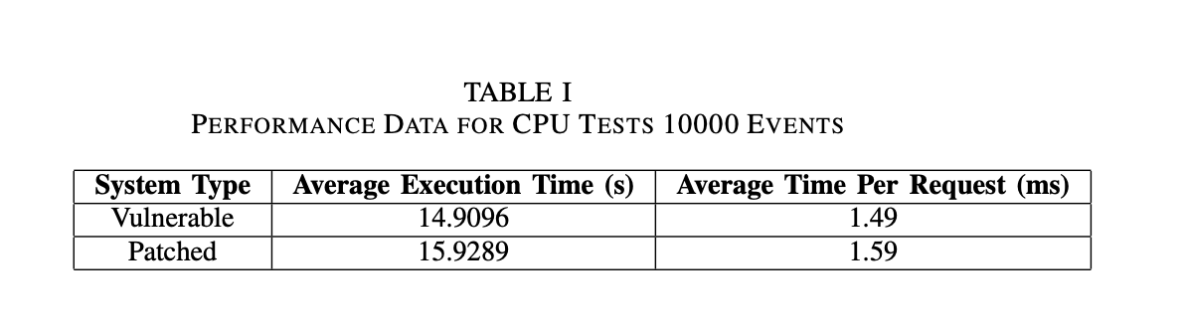
Results

Slide 11
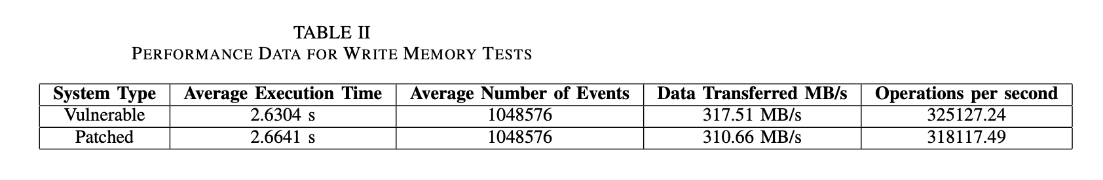
Results

Slide 12
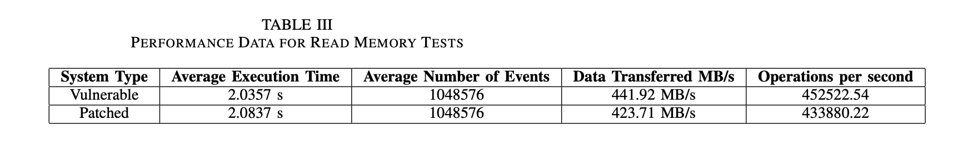
Results

Slide 13
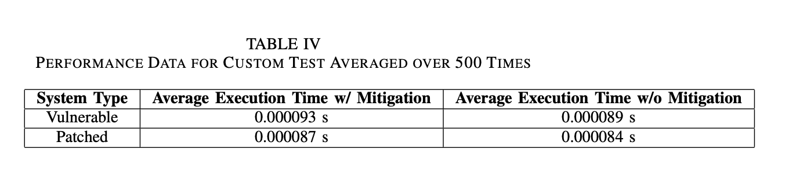
Results

Slide 14
Findings
The patched Ubuntu VM took a minor performance hit from the Sysbench suite checks
The custom C program slowed with the mitigation macro in place, but excuted faster on the patched system

Slide 15
Conclusions
Systems that can be patched, should be patched
Systems that cannot be patched, should have mitigations in place like the speculation barrier code
Better mitigations that don’t effect performance as much should be developed
Until new processors are created, the vulnerabilities will always exist in some form

Slide 16
Future Work
More research needs to be done with a larger number of devices and many different types
Better macros can be written to perform better while still mitigating the vulnerabilities
The actual effect of IOT devices in the wild and how they perform after mitigations are in place

